Slide 1
Lecture 7
Curved paths
Projectile and Circular Motions

Slide 2
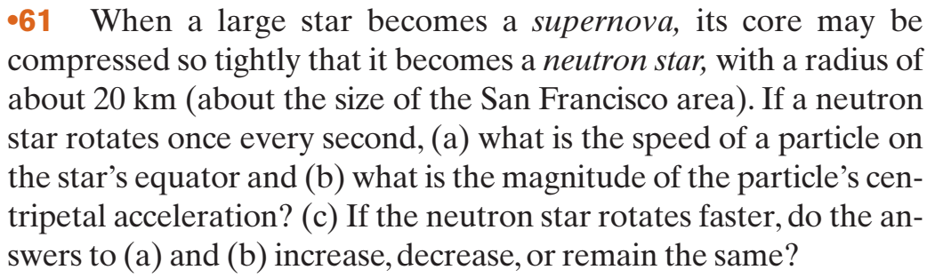











Lecture 7

Slide 3
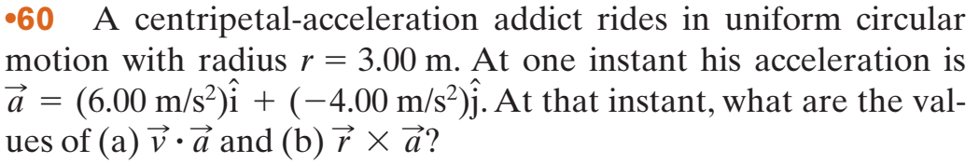















Lecture 7

Slide 4

























Lecture 7

Slide 5


Lecture 7

Slide 6





Lecture 7

Slide 7
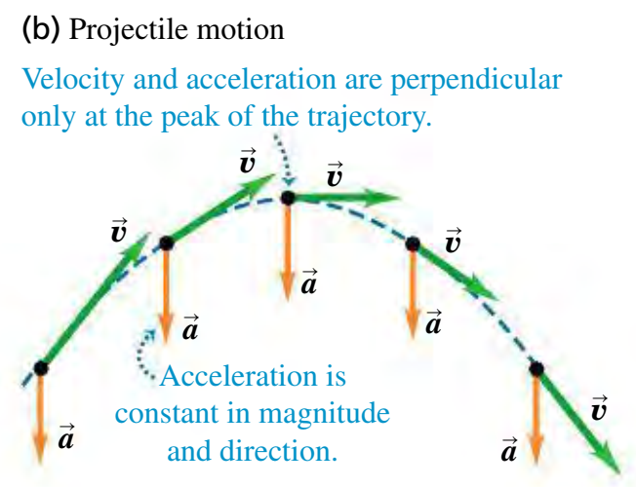





Lecture 7
Demonstrations

Slide 8
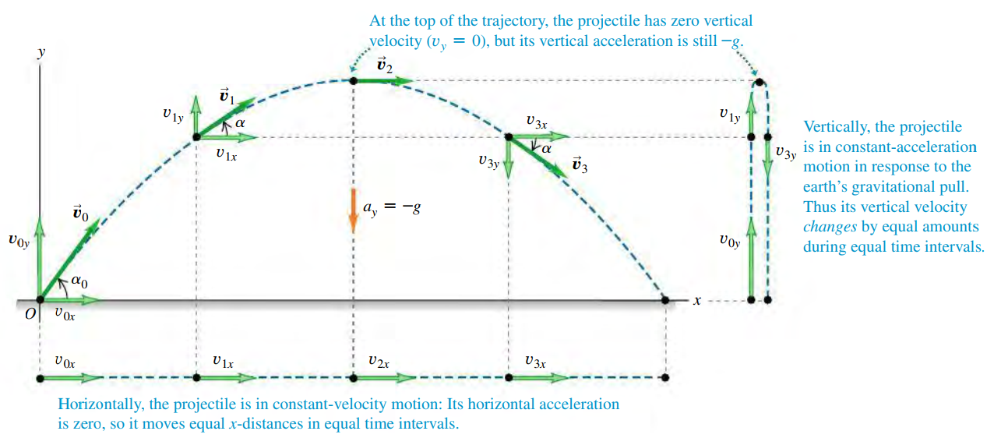

Lecture 7

Slide 9

















Lecture 7

Slide 10
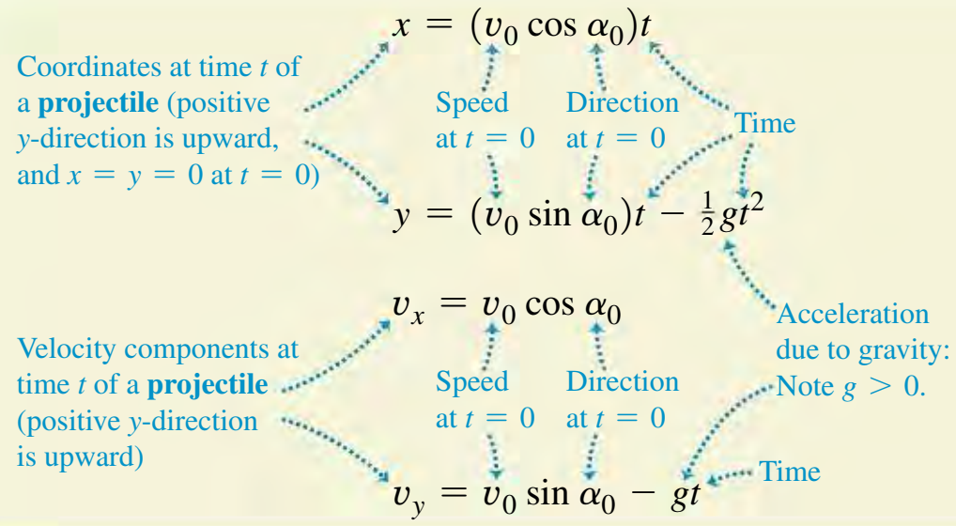


Lecture 7

Slide 11
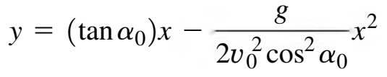
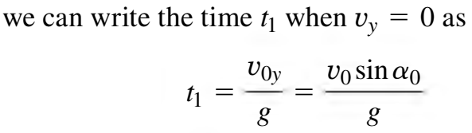
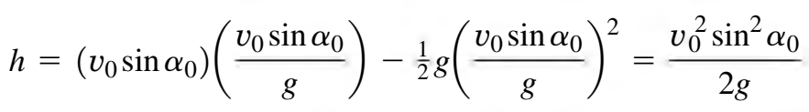
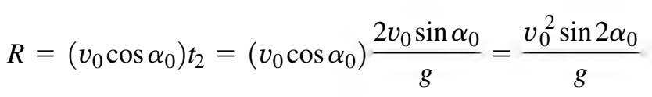

































Lecture 7

Slide 12
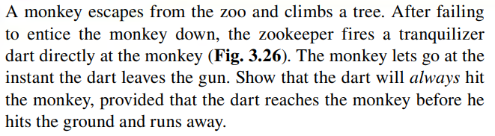




















Lecture 7

Slide 13
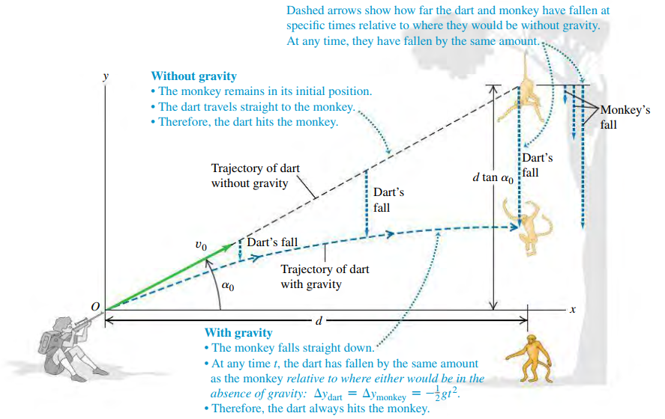











Lecture 7

Slide 14
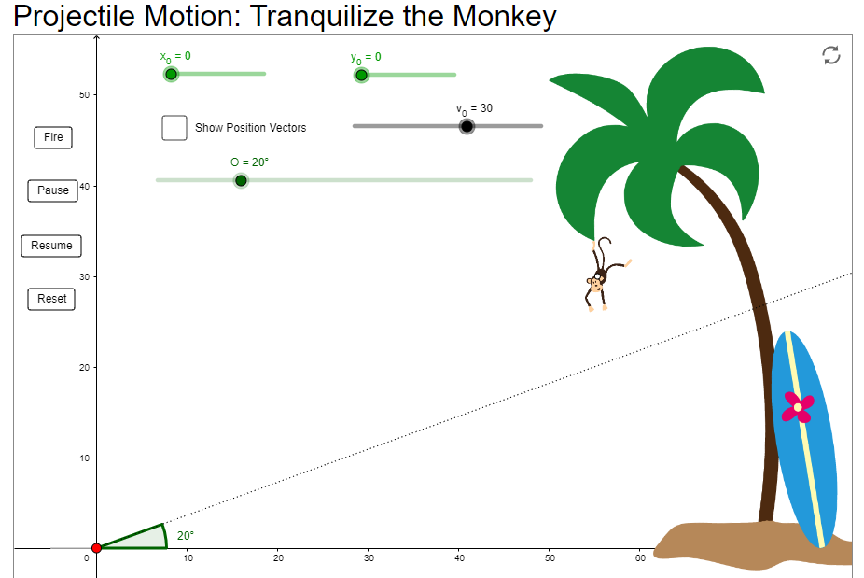










Lecture 7
Try it Yourself here

Slide 15













Lecture 7

Slide 16
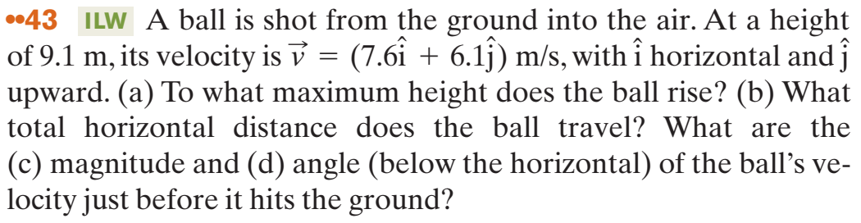


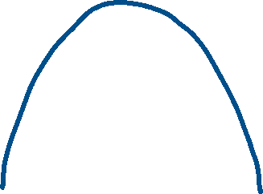



Lecture 7

Slide 17







Lecture 7

Slide 18
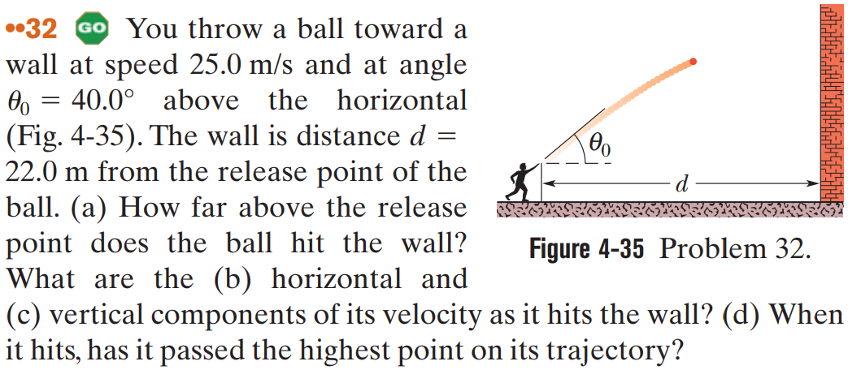
Lecture 7

Slide 19




Lecture 7

Slide 20


















Lecture 7

Slide 21






Lecture 7

Slide 22



Lecture 7

Slide 23
Lecture 7
Practice problems:
Problems from Fundamentals of Physics
-Jearl Walker
Chapter 4 : Motion in Two and Three dimension
Page#86
17, 35, 42, 48, 67
Additional Problems
Additional Problems 90, 92, 85

